Slide 1
Designing a Scalable Data Cleaning Infrastructure
Daniel Haas
In Collaboration With: Sanjay Krishnan, Jiannan Wang, Juan Sanchez, Wenbo Tao, Eugene Wu, Ken Goldberg, Mike Franklin

Slide 2
Outline
What we think matters for data cleaning
Our system design
Releases/opportunities for collaboration

Slide 3
Outline
What we think matters for data cleaning
Our system design
Releases/opportunities for collaboration

Slide 4
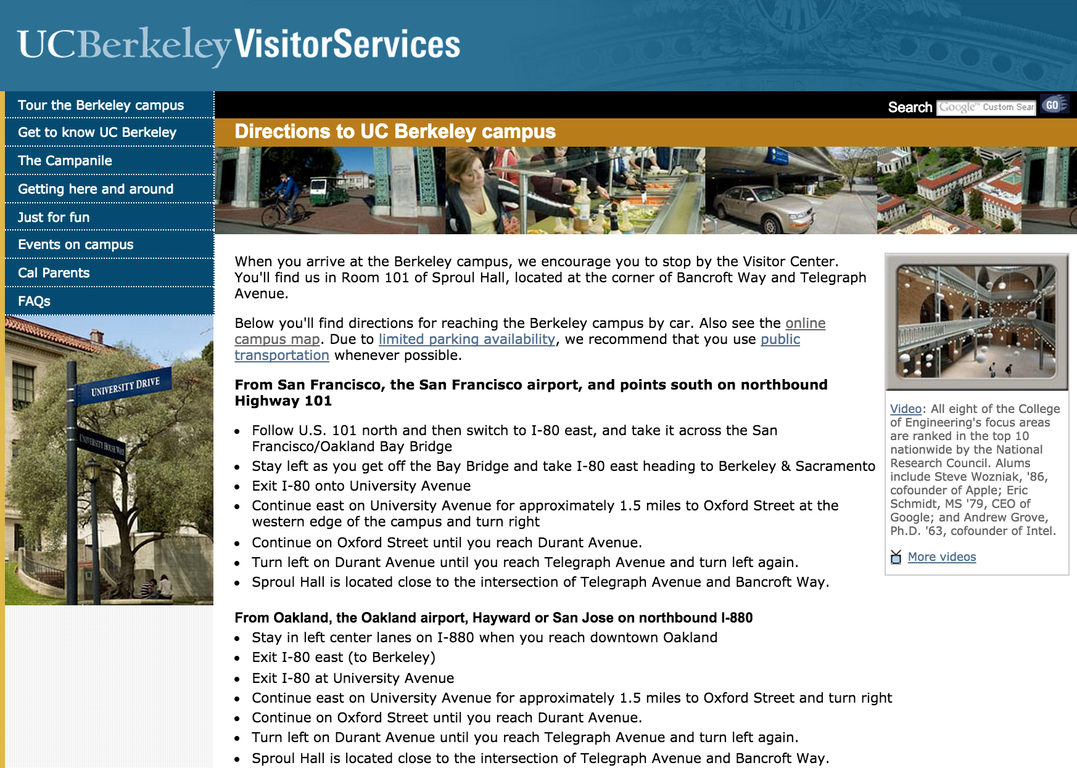
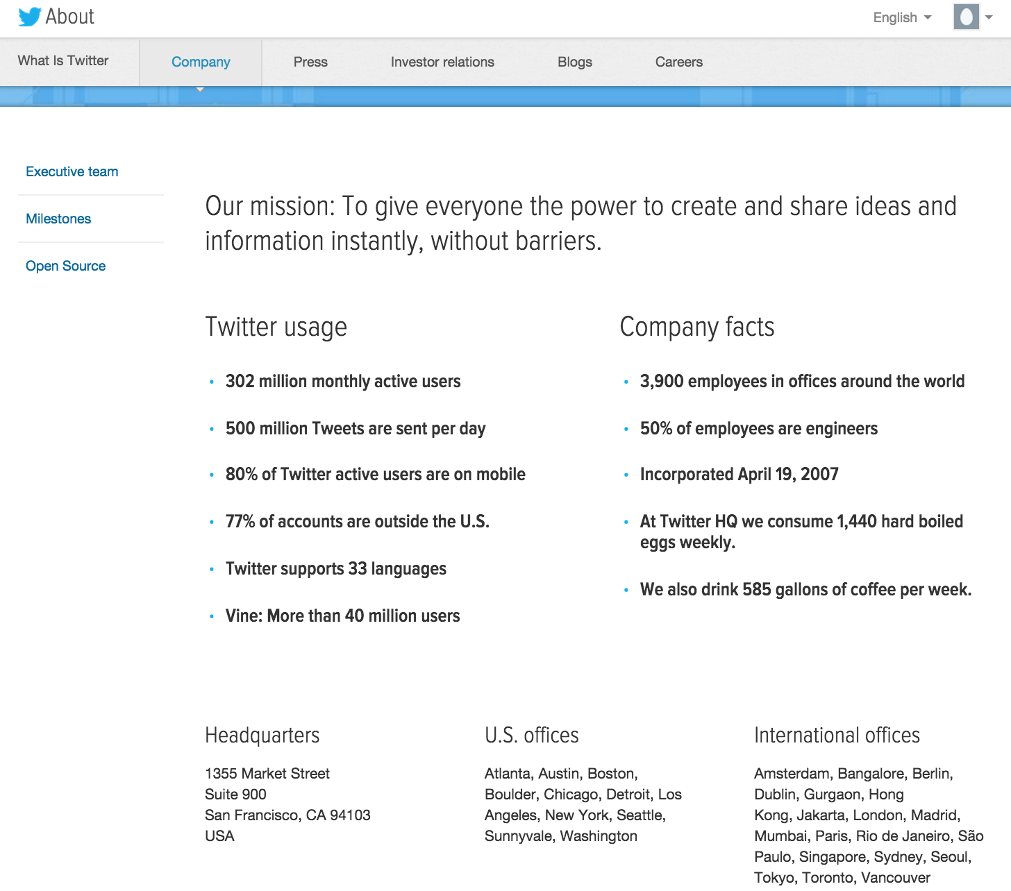
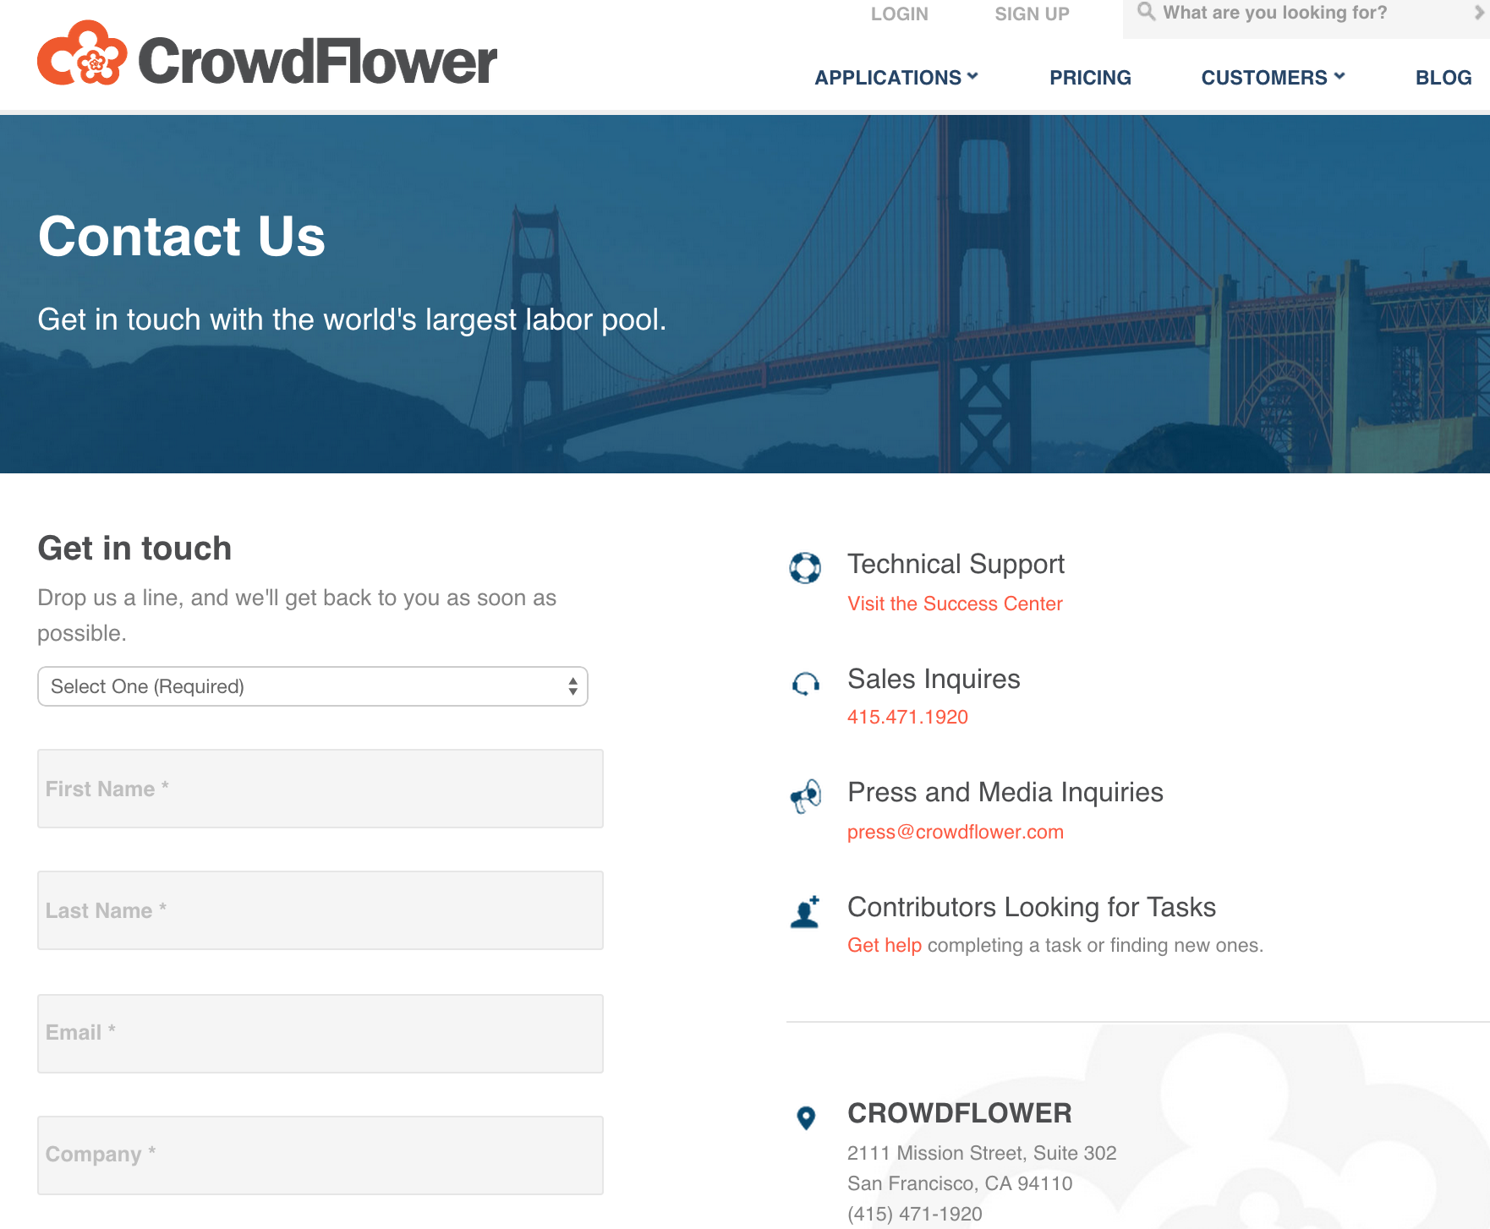
An Example Cleaning Lifecycle
Goal: extract addresses from a dataset of webpages
???

Slide 5
An Example Cleaning Lifecycle
Goal: extract addresses from a dataset of webpages
First: try simple rules on a sample
Works great!
1.
webpages
Count(*)
Sample
Rule: Extract address

Slide 6

An Example Cleaning Lifecycle
Goal: extract addresses from a dataset of webpages
Next: apply rules to whole data
Lots of errors, feel sad
2.
webpages
Rule: Extract address

Slide 7
An Example Cleaning Lifecycle
Goal: extract addresses from a dataset of webpages
So, try the crowd!
Great results
Lots of engineering
Very slow
3.
webpages
Crowd: Extract address

Slide 8
An Example Cleaning Lifecycle
Goal: extract addresses from a dataset of webpages
Finally, settle on a hybrid approach.
Rules for simple cases
Crowds for hard cases
ML to make crowds scale
4.
webpages
Rule: Extract address
Crowd + Active Learning:
Extract address

Slide 9
How to make the lifecycle easier?
General, composable operators
Support for iteration on workflows
Optimization for workflow search
Integrated tools for crowdsourcing

Slide 10
Outline
What we think matters for data cleaning
Our system design
Releases/opportunities for collaboration

Slide 11
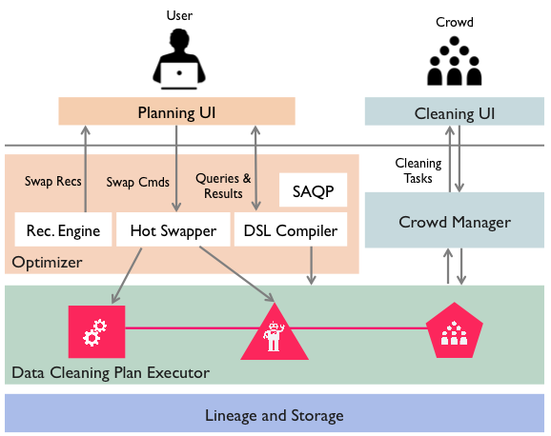
“Our System”

Slide 12



General, composable operators
Logical Operators
Physical Operators
Sampling
Rule-based
Similarity Join
Learning-based
Filtering
Crowd-based
Extraction

Slide 13
Support for iteration
Observation:
Cleaning workflows require many changes to work well
Solution:
“Hot-swapping” which:
Can modify in-flight logical operators
Uses caching and lineage to avoid re-computing intermediate results

Slide 14
Optimization for workflow search
Observation:
Data scientists tweak workflows using heuristics and intuition
Solution:
An eval operator which:
Gathers ground truth
Estimates the cost / quality of a workflow
Recommends changes to improve quality / decrease cost

Slide 15
Integrated crowdsourcing
Observation
Many cleaning operations require human guidance but need to scale
Solution:
AMPCrowd, a standalone web service with:
Support for MTurk or an internal crowd
Built-in quality control (voting, EM)
Extensibility to new task interfaces, new crowd platforms

Slide 16
Summary:
Operators: logical, physical, composable
Iteration: hot-swapping mid-flight
Optimization: the eval operator
Crowdsourcing: the AMPCrowd platform

Slide 17
Outline
What we think matters for data cleaning
Our system design
Releases/opportunities for collaboration

Slide 18
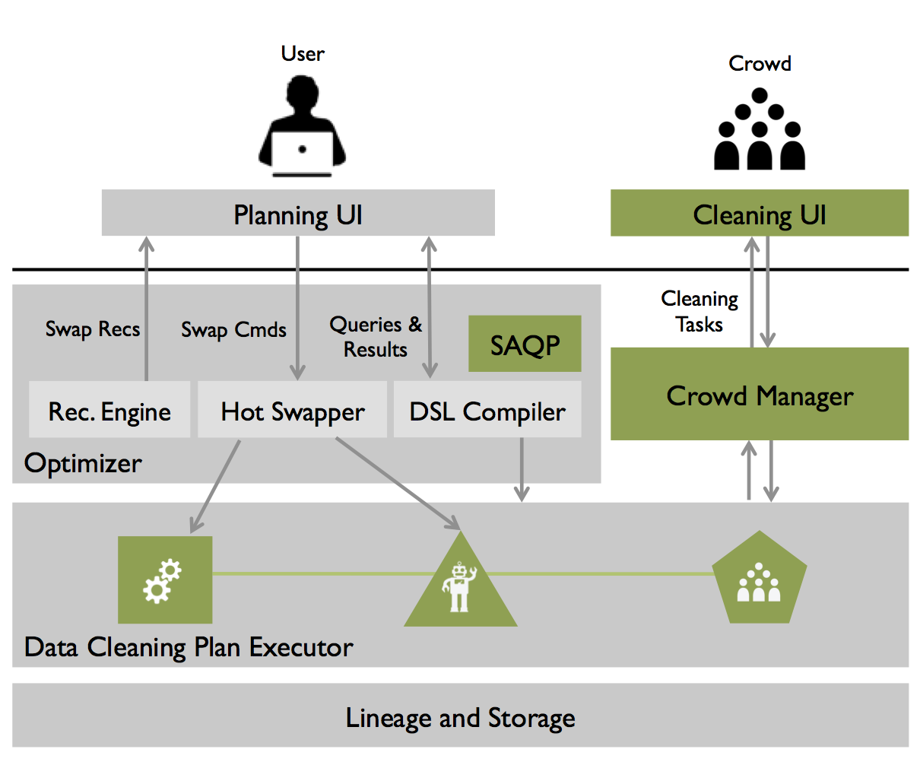
Initial System Release
Built on the BDAS stack (Scala)
Apache licensed
Release within the next month!

Slide 19
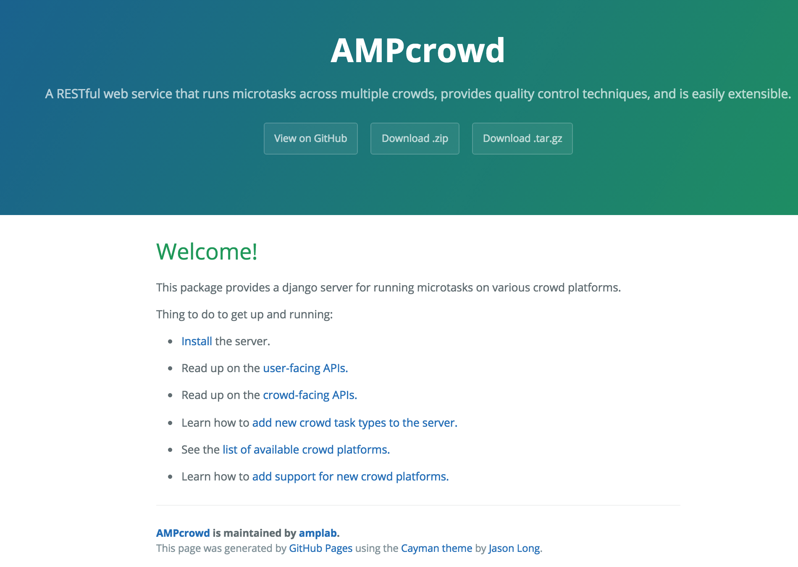
AMPCrowd Release
amplab.github.io/ampcrowd
Python/Django/Postgresql
Apache Licensed

Slide 20
User
Crowd
Planning UI
Cleaning UI
Optimizer
Cleaning Tasks
Swap Recs
Swap Cmds
Queries &
Results
SAQP
Crowd Manager
Rec. Engine
Hot Swapper
DSL Compiler
Data Cleaning Plan Executor
Lineage and Storage

Slide 21

Questions for you
For discussion now:
How do you handle dirty data?
Would our system be useful?
… and many more
Take our survey! Goals:
Inform our system design
Publish our findings

Slide 22
Questions for us?
Thanks!
{dhaas, sanjay, jnwang}@cs.berkeley.edu
ewu@cs.columbia.edu
sampleclean.org

Slide 23
SAQP: Tradeoff Between Accuracy and Cleaning
Query
Error
BlinkDB
No Cleaning
SampleClean
Sample Size
SIGMOD 2014. SampleClean: Fast and Accurate Query Processing on Dirty Data

Slide 24

Broad View of Data Cleaning
Materialized View
Approx.
Result
Query
Sample
View
Outlier
Index
Base Data
Updates
Submitted VLDB 2015. Stale View Cleaning: Getting Fresh Answers From Materialized Views
Notes:
----- Meeting Notes (1/13/15 15:01) -----
outlier indexing

Slide 25
Data cleaning for Machine Learning?
Θ*
Correction
Dirty
Data
Clean
Data

Slide 26
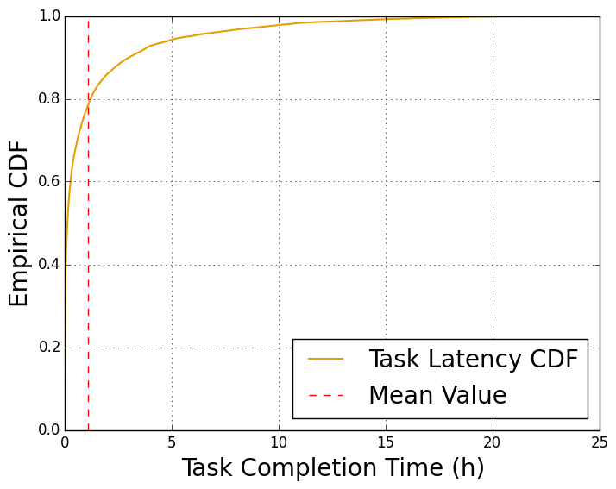
Tackling crowd latency
Our approach: treat crowd workers like nodes in a distributed system!
Detect slow/low-quality workers
Mitigate straggling workers
Tune active learning hyper-parameters for performance

